Slide 1

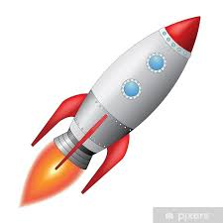
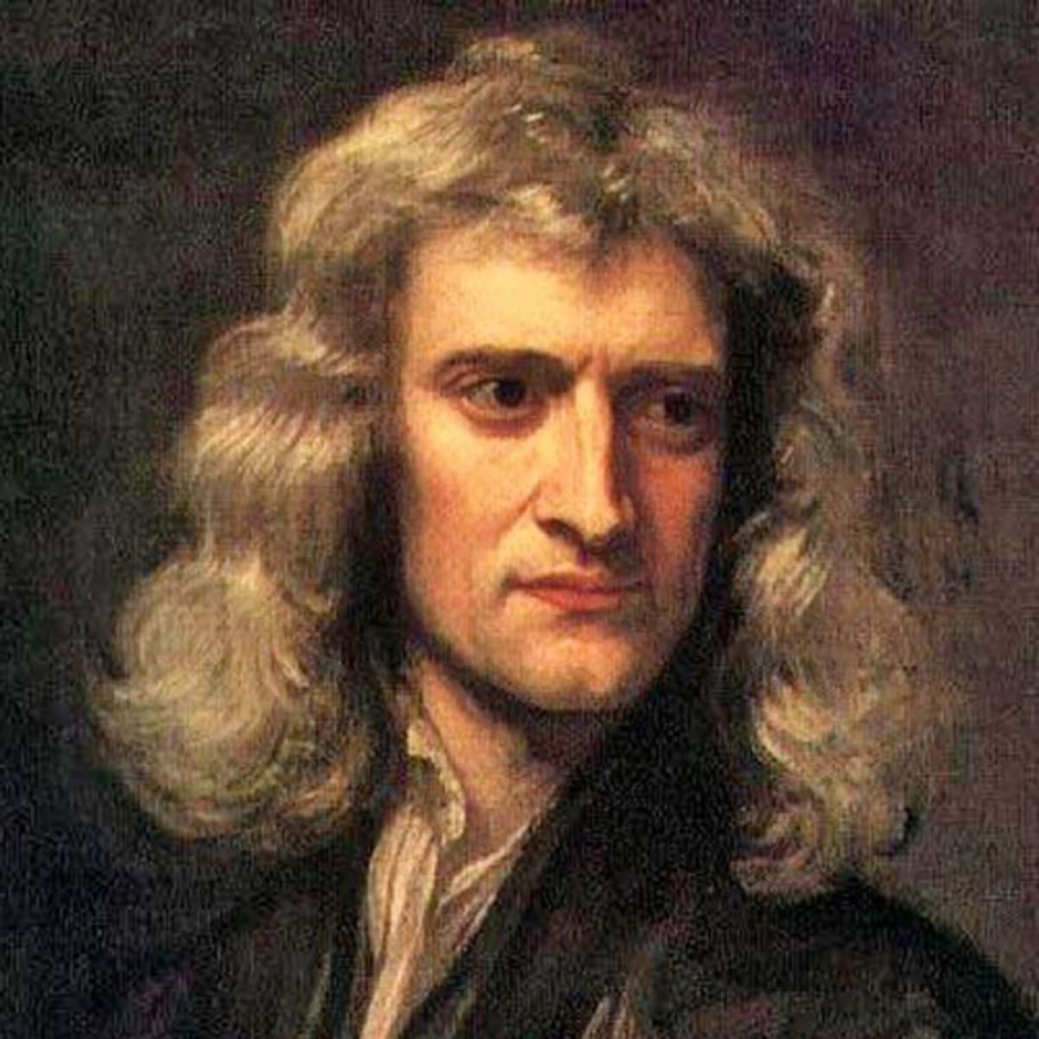
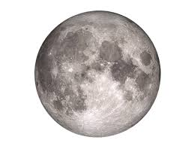
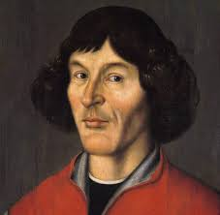
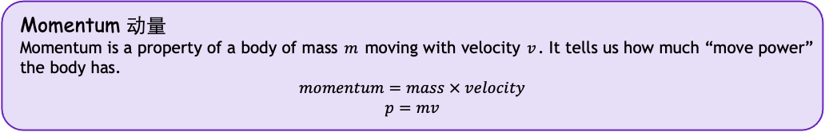
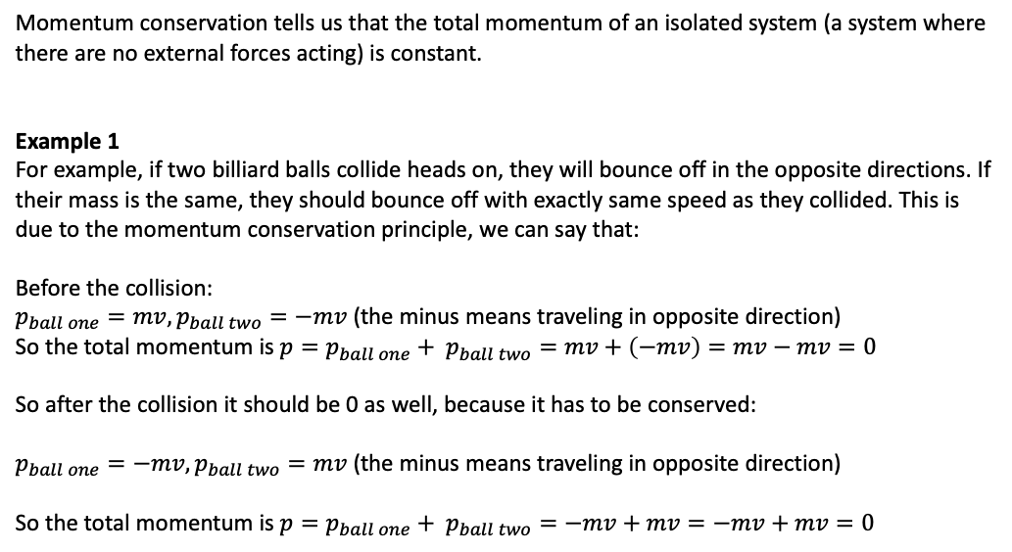
解密神奇的宇宙 Unlocking the secrets of the Universe
Project: the Rocket Equation
How do rocket’s work?
Today’s VIP guest list
A modern space rocket, like the one that took humans to the Moon, and hopefully will soon take astronauts to Mars, burns fuel and exhausts it with high speed towards Earth. Why does this cause the rocket to accelerate?
This has to do with Newton’s principle of momentum conservation.
Isaac Newton
Momentum 动量
Momentum is a property of a body of mass $m$ moving with velocity $v$. It tells us how much “move power” the body has.
$$momentum=mass × velocity$$
$$p=mv$$
Momentum conservation tells us that the total momentum of an isolated system (a system where there are no external forces acting) is constant.
Example 1
For example, if two billiard balls collide heads on, they will bounce off in the opposite directions. If their mass is the same, they should bounce off with exactly same speed as they collided. This is due to the momentum conservation principle, we can say that:
Before the collision:
$p_{ball one}=mv, p_{ball two}=−mv$ (the minus means traveling in opposite direction)
So the total momentum is $p=p_{ball one}+ p_{ball two}=mv+\left(−mv\right)=mv−mv=0$
So after the collision it should be 0 as well, because it has to be conserved:
$p_{ball one}=−mv, p_{ball two}=mv$ (the minus means traveling in opposite direction)
So the total momentum is $p=p_{ball one}+ p_{ball two}=−mv+mv=−mv+mv=0$

Slide 2
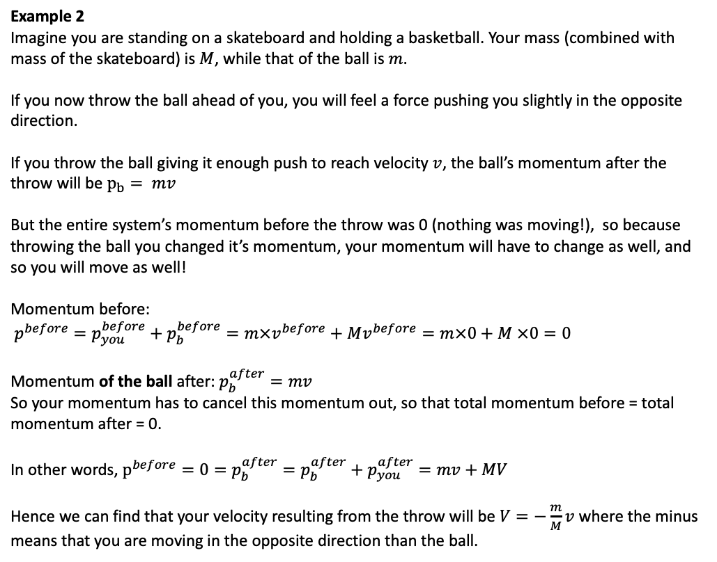
Example 2
Imagine you are standing on a skateboard and holding a basketball. Your mass (combined with mass of the skateboard) is $M$, while that of the ball is $m$.
If you now throw the ball ahead of you, you will feel a force pushing you slightly in the opposite direction.
If you throw the ball giving it enough push to reach velocity $v$, the ball’s momentum after the throw will be $p_{b}= mv$
But the entire system’s momentum before the throw was 0 (nothing was moving!), so because throwing the ball you changed it’s momentum, your momentum will have to change as well, and so you will move as well!
Momentum before:
$p^{before}=p_{you}^{before}+p_{b}^{before}=m×v^{before}+Mv^{before}=m×0+M ×0=0$
Momentum of the ball after: $p_{b}^{after}=mv$
So your momentum has to cancel this momentum out, so that total momentum before = total momentum after = 0.
In other words, $p^{before}=0=p_{b}^{after}=p_{b}^{after}+p_{you}^{after}=mv+MV$
Hence we can find that your velocity resulting from the throw will be $V=−\frac{m}{M}v$ where the minus means that you are moving in the opposite direction than the ball.
Today’s VIP guest list
Isaac Newton

Slide 3

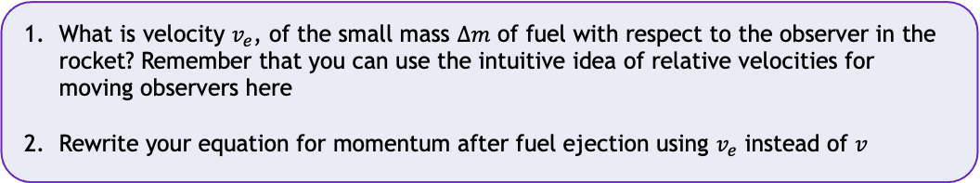

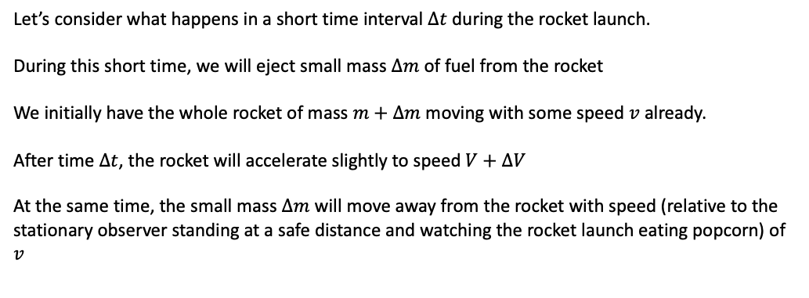
解密神奇的宇宙 Unlocking the Secrets of the Universe
Momentum conservation for rocket propulsion system
Let’s consider what happens in a short time interval $Δt$ during the rocket launch.
During this short time, we will eject small mass $Δm$ of fuel from the rocket
We initially have the whole rocket of mass $m+Δm$ moving with some speed $v$ already.
After time $Δt$, the rocket will accelerate slightly to speed $V+ΔV$
At the same time, the small mass $Δm$ will move away from the rocket with speed (relative to the stationary observer standing at a safe distance and watching the rocket launch eating popcorn) of $v$
Task 1
Create a drawing of this situation at time $t=0$ and then at time $t=Δt$
Write down the total momentum of this system at both times. Be careful with signs (plus or minus).
1
Task 2
What is velocity $v_{e}$, of the small mass $Δm$ of fuel with respect to the observer in the rocket? Remember that you can use the intuitive idea of relative velocities for moving observers here
Rewrite your equation for momentum after fuel ejection using $v_{e}$ instead of $v$
Task 3
Apply the momentum conservation principle to figure out what $ΔV$ is in terms of $Δm$. You should be able to express this as a single equation.
JinJin STEM Academy

Slide 4
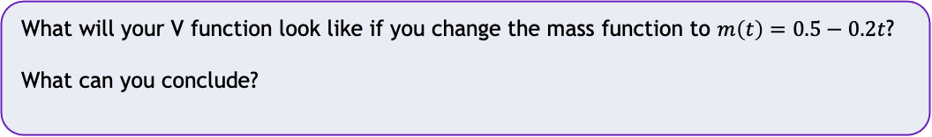
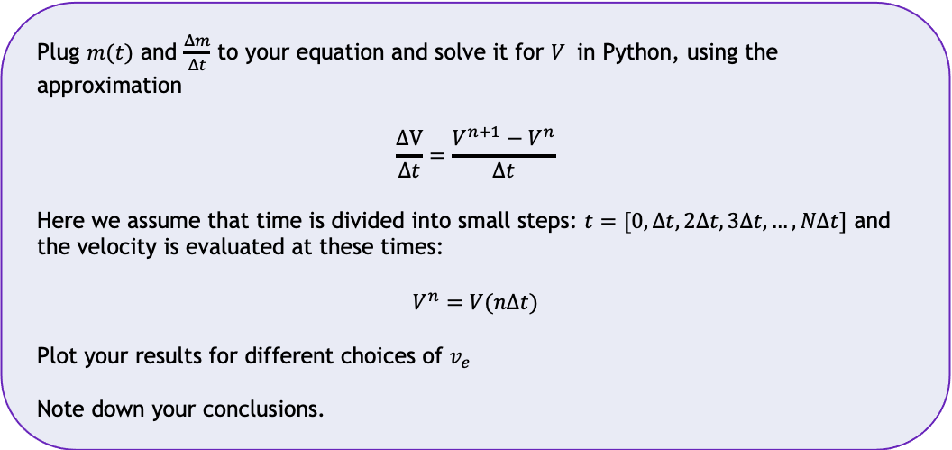

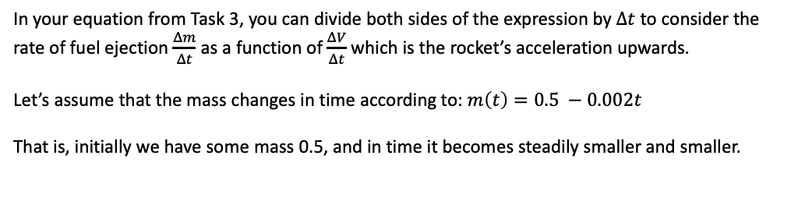
解密神奇的宇宙 Unlocking the Secrets of the Universe
Acceleration vs. fuel ejection rate
In your equation from Task 3, you can divide both sides of the expression by $Δt$ to consider the rate of fuel ejection $\frac{Δm}{Δt}$ as a function of $\frac{ΔV}{Δt}$ which is the rocket’s acceleration upwards.
Let’s assume that the mass changes in time according to: $m\left(t\right)=0.5 −0.002t$
That is, initially we have some mass 0.5, and in time it becomes steadily smaller and smaller.
Task 4
What is the rate of change of mass $\frac{Δm}{Δt}$ in this case? (HINT: what does the mass function look like?)
Task 5
1
Plug $m(t)$ and $\frac{Δm}{Δt}$ to your equation and solve it for $V$ in Python, using the approximation
$$\frac{ΔV}{Δt}=\frac{V^{n+1}−V^{n}}{Δt}$$
Here we assume that time is divided into small steps: $t=[0, Δt, 2Δt,3Δt,…,NΔt]$ and the velocity is evaluated at these times:
$$V^{n}=V(nΔt)$$
Plot your results for different choices of $v_{e}$
Note down your conclusions.
Task 6
What will your V function look like if you change the mass function to $m\left(t\right)=0.5−0.2t$?
What can you conclude?
JinJin STEM Academy

